Slide 1
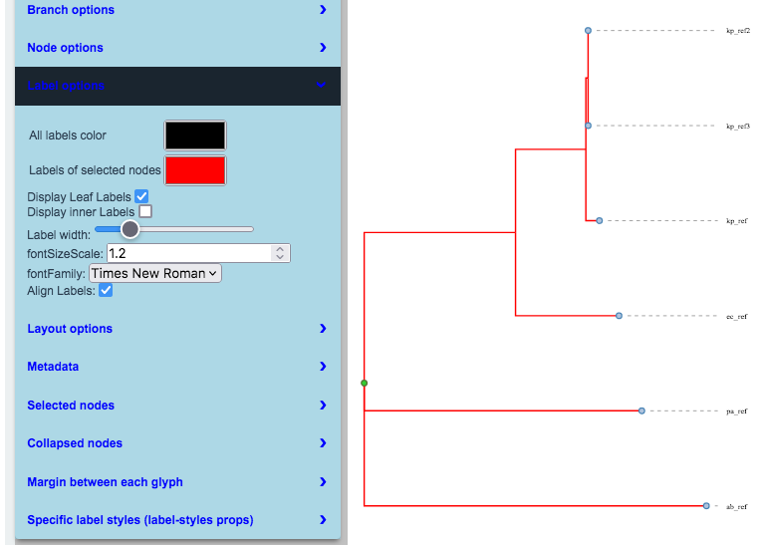
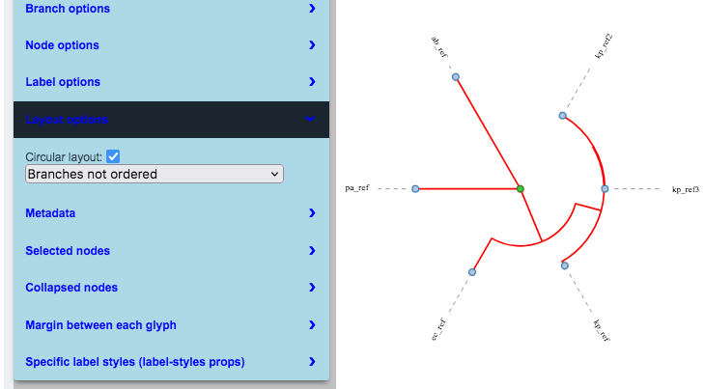
Recombinant-free alignment
Trimmed alignment
Nucleotide substitution model determination
Phylogenetic tree Visualization, customization, and export
Core SNP
a local Bacterial/Archaea genomic dataset from NCBI Genome database
Strategy 1
CoreSNP-based approach:
fit for highly related strains
Phylogenetic tree inference
Core-genome
analysis
Core genes alignment
Trimmed alignment
Nucleotide substitution model determination
Core SNP
Genomic annotation
a. Genomic assembly number
b. costumed genomic sequences as fasta format
Strategy 2
Conserved genes-based approach: fit for relatively distantly related strains
Input genomes
Maker gene
identification
Maker gene alignment
Trimmed alignment
Protein substitution model determination
Phylogenetic tree inference
Strategy 3
ANI-based approach: fir for relatively closely related strains
tANI calculation
Bootstrapped matrix
Phylogenetic tree inference
upload
Figure1. The workflow for pubAutoTree. Users have the option to either provide the assembly numbers of the genomes they wish to analyze or upload genome sequence files. Upon providing the assembly numbers, pubAutoTree will promptly retrieve the corresponding genome sequences from its local genomic database, which is updated daily with the NCBI genome database. From among the three available methods, users can select one to construct a maximum likelihood tree. Once the phylogenetic tree is completed, users can instantly visualize, customize, and export the phylogenetic tree map in either SVG or JPEG format.

